Slide 1

Deep Learning Crash Course
Hui Xue
Fall 2021
www.deeplearningcrashcourse.org

Slide 2
Outline
CNN architectures
Object detection
Segmentation
Denoising and super-resolution

Slide 3
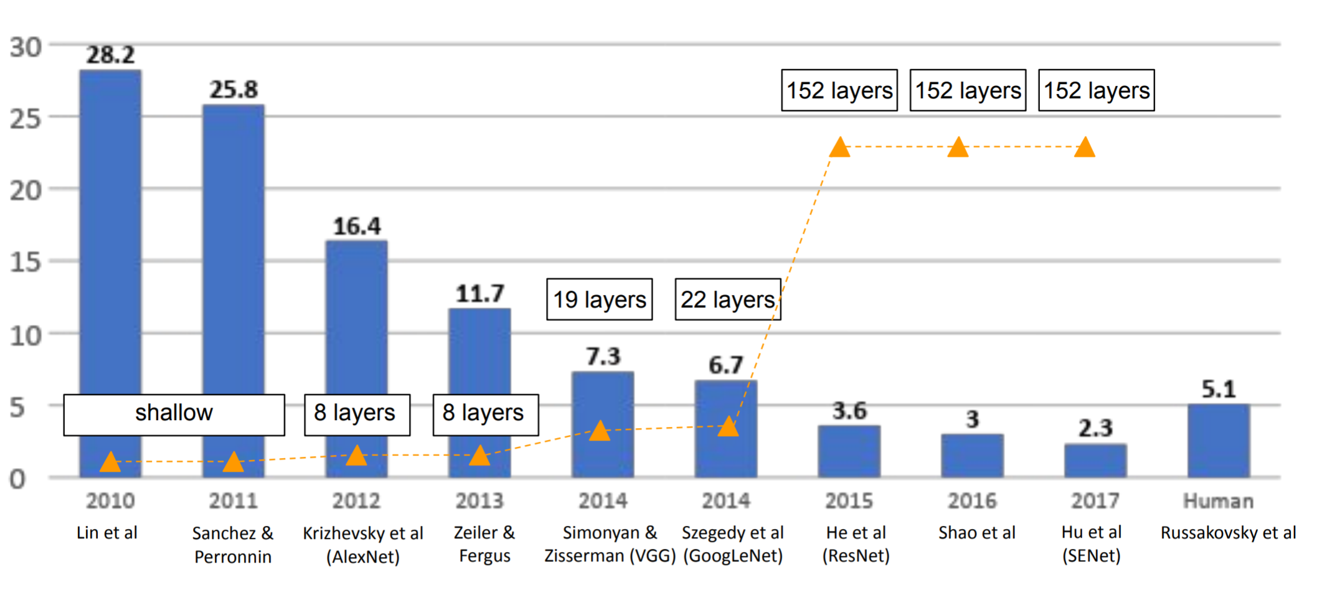
ImageNet winners
~61M parameters
Backprop to train CONV
Use ave max pooling
Use tanh ReLU
Use flatten and FC
Use softmax and CE loss
Increase number of filters with reduced spatial resolution
Much bigger
Data augmentation
Use GPU for training
Much larger dataset
CONV1
ReLU
Max Pool
CONV2
ReLU
Max Pool
CONV3
ReLU
CONV4
ReLU
CONV5
ReLU
Max Pool
Flatten
FC1
ReLU
FC2
ReLU
FC3
AlexNet
Logits
Bx1000
Bx3x227x227
… …

Slide 4
Z-F net, 2013
CONV1
ReLU
Max Pool
CONV2
ReLU
Max Pool
CONV3
ReLU
CONV4
ReLU
CONV5
ReLU
Max Pool
Flatten
FC1
ReLU
FC2
ReLU
FC3
ZF Net
Logits
Bx1000
Bx3x227x227
11x11, stride 4 → 7x7, stride 2
K=384 → K=512
By then, indicate the potential of CONV networks
Win the #1 place by hyperparameter searching
K=384 → K=1024
Top 5 accu: 16.4% → 11.7%
K=256 → K=512
Visualizing and Understanding Convolutional Networks. https://arxiv.org/abs/1311.2901

Slide 5
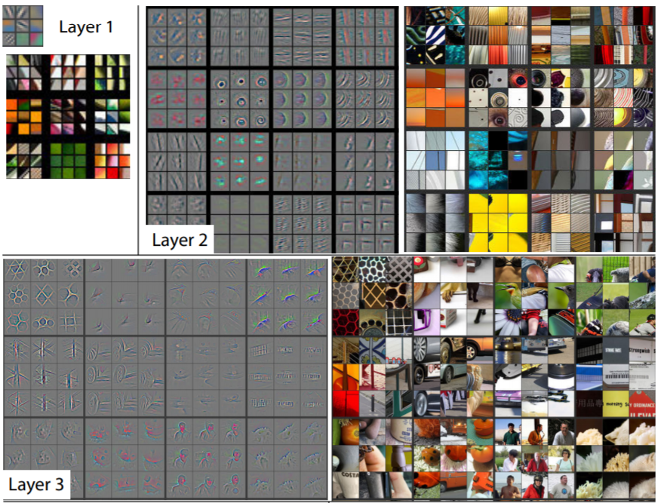
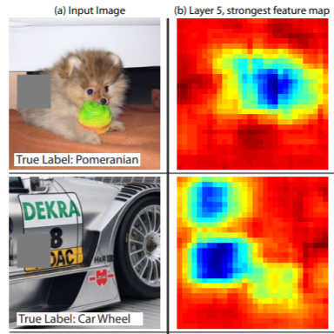
Z-F net paper has other contributions
A seminal paper for neural network visualization
Insights to understand convnet
More in the NN visualization later
Visualizing and Understanding Convolutional Networks. https://arxiv.org/abs/1311.2901

Slide 6
VGG net, 2014
CONV, 3x3, 64
CONV, 3x3, 64
Max Pool
CONV, 3x3, 128
CONV, 3x3, 128
Max Pool
CONV, 3x3, 256
CONV, 3x3, 256
CONV, 3x3, 256
Max Pool
CONV, 3x3, 512
CONV, 3x3, 512
CONV, 3x3, 512
Max Pool
CONV, 3x3, 512
CONV, 3x3, 512
CONV, 3x3, 512
Max Pool
FC1, D=4096
FC2, D=4096
FC3, D=1000
For Bx3x224x224 inputs
VGG16: ~138M parameters
FC1: ~74% of total #paras
VGG 16
Logits
CONV, 3x3, 64
CONV, 3x3, 64
Max Pool
CONV, 3x3, 128
CONV, 3x3, 128
Max Pool
CONV, 3x3, 256
CONV, 3x3, 256
CONV, 3x3, 256
CONV, 3x3, 256
Max Pool
CONV, 3x3, 512
CONV, 3x3, 512
CONV, 3x3, 512
CONV, 3x3, 512
Max Pool
CONV, 3x3, 512
CONV, 3x3, 512
CONV, 3x3, 512
CONV, 3x3, 512
Max Pool
FC1, D=4096
FC2, D=4096
FC3, D=1000
VGG 19
Logits
Go deeper!
Alexnet 8 layers with weights to 16 – 19 layers
Only use 3x3 conv kernel with stride 1 → do not change image size
Solely relying on max pooling to reduce image size
ReLU after every CONV
Top 5 accu: 11.7% → 7.3%
Very Deep Convolutional Networks for Large-Scale Image Recognition. https://arxiv.org/abs/1409.1556

Slide 7
VGG net, 2014
Stack small CONV layers to gain larger receptive fields
Reduced computation
Cleaner architecture design
Still has the expensive FC layer
CONV, 3x3, padding 1, stride 1
CONV, 3x3, padding 1, stride 1
CONV, 3x3, padding 1, stride 1
Very Deep Convolutional Networks for Large-Scale Image Recognition. https://arxiv.org/abs/1409.1556

Slide 8
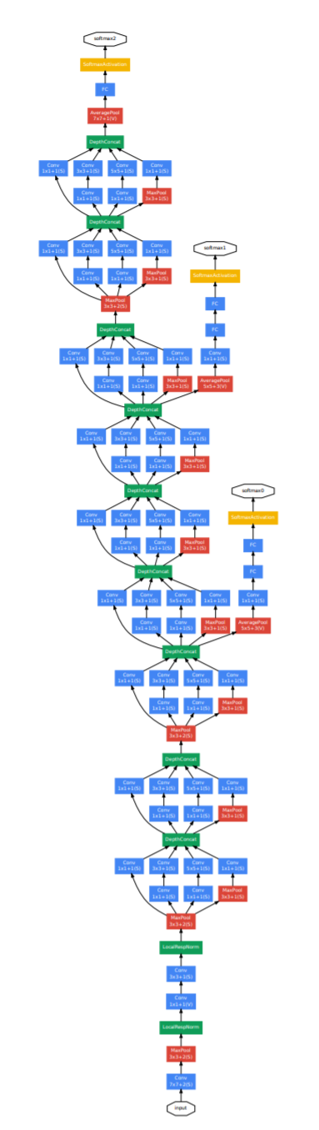
GoogLeNet, 2014
loss
Go deeper and go wider !
22 layers
Inception module
Extensively using 1x1 conv layer
Remove the expensive FC layer
Use intermediate feature maps for loss computation
Only ~5M parameters
Top 5 accu: 11.7% → 6.7%

Slide 9
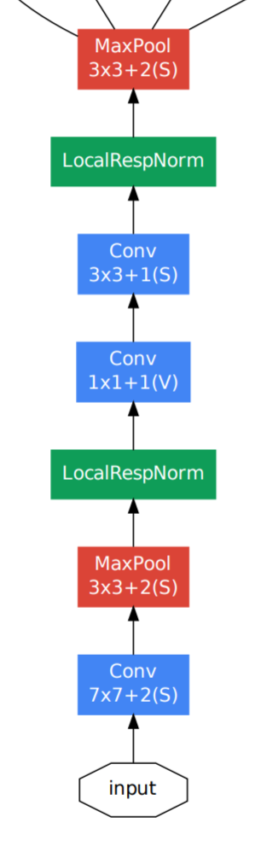
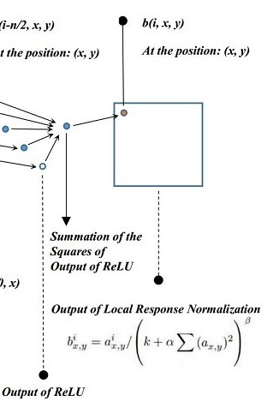
GoogLeNet, 2014
loss
Staring phase:
192x28x28
192x56x56
64x56x56
Local response normalization
64x112x112
3x224x224
https://www.quora.com/What-is-local-response-normalization

Slide 10
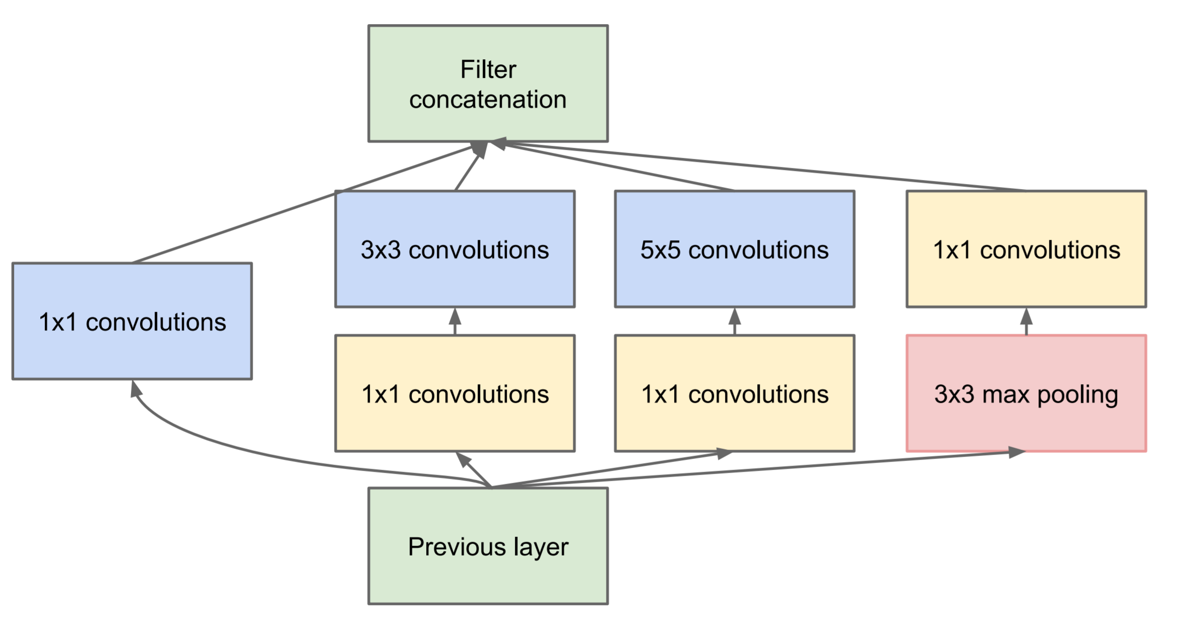
GoogLeNet, 2014
loss
Inception module:
(128+192+96+64) x28x28
Concatenate along channel
Instead of having a single pass, having multiple passes
Use 1x1 conv to reduce computation
Concatenate along channels
64x28x28
128x28x28
192x28x28
96x28x28
64x28x28
64x28x28
192x28x28
192x28x28

Slide 11
Google Inception net, 2014
loss
Stack several inception modules with different number of output channels
Instead of having a single pass, having multiple passes
Use 1x1 conv to reduce computation
Concatenate along channels
Concatenate along channel
64x28x28
128x28x28
192x28x28
96x28x28
64x28x28
64x28x28
192x28x28
192x28x28

Slide 12
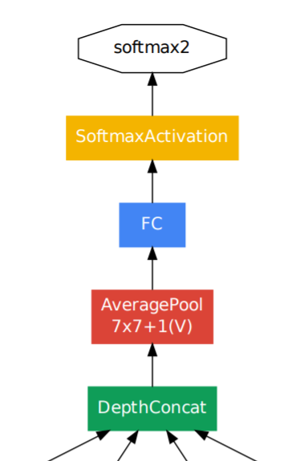
Google Inception net, 2014
loss
Output phase:
Averaging pooling for every 2D feature map, CxHxW → Cx1x1
Avoid the expensive FC layer
Avoid flatten layer

Slide 13
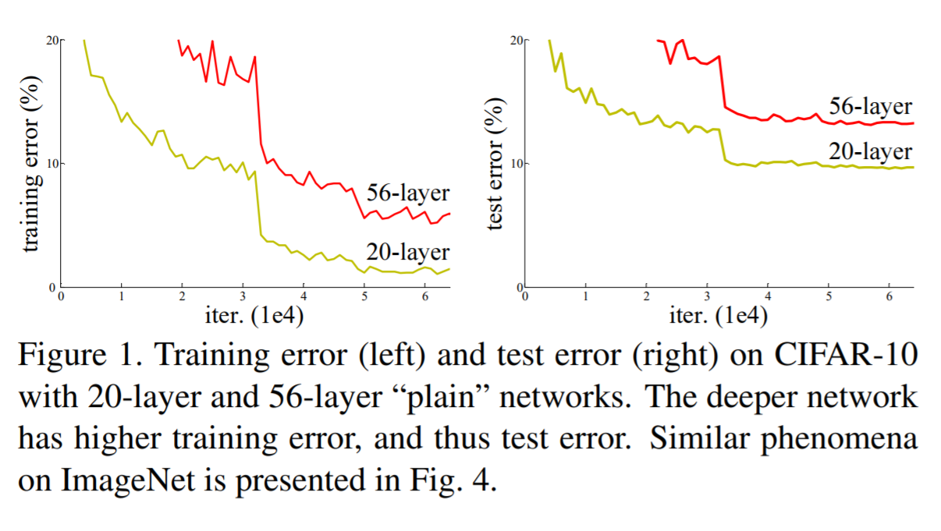
Resnet, 2015
“Going deeper” improves performance
But getting harder to train (mitigated by GoogLeNet, not an ideal solution)
Is this due to over-fitting?
Deep Residual Learning for Image Recognition. https://arxiv.org/abs/1512.03385

Slide 14
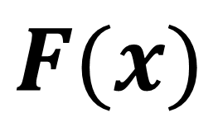
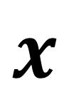
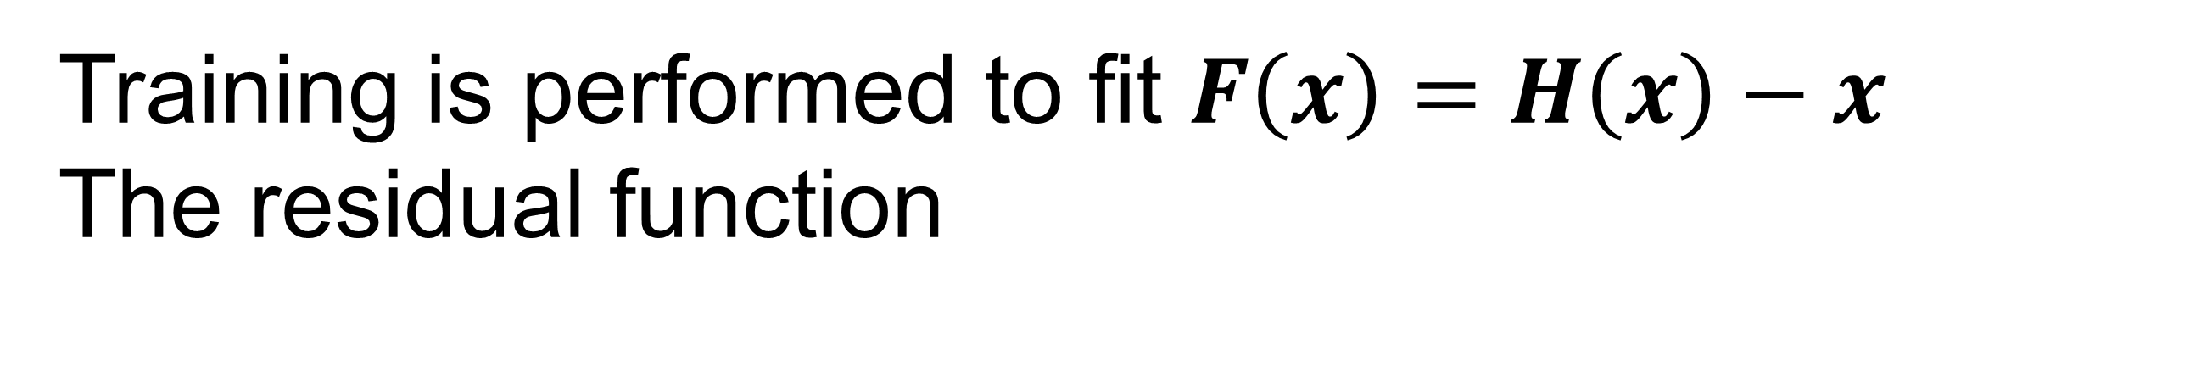
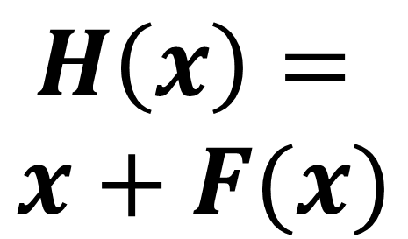
Resnet : residual connection
$$F(x)$$
CONV1
ReLU
CONV1
$$H\left(x\right)=$$
$$x+F(x)$$
ReLU
$$x$$
Residual connection
Allow gradient flow to pass through
Make training deeper network easier, if there are enough data
No extra parameters
Constraint on network design
Training is performed to fit $F\left(x\right)=H\left(x\right)−x$
The residual function

Slide 15
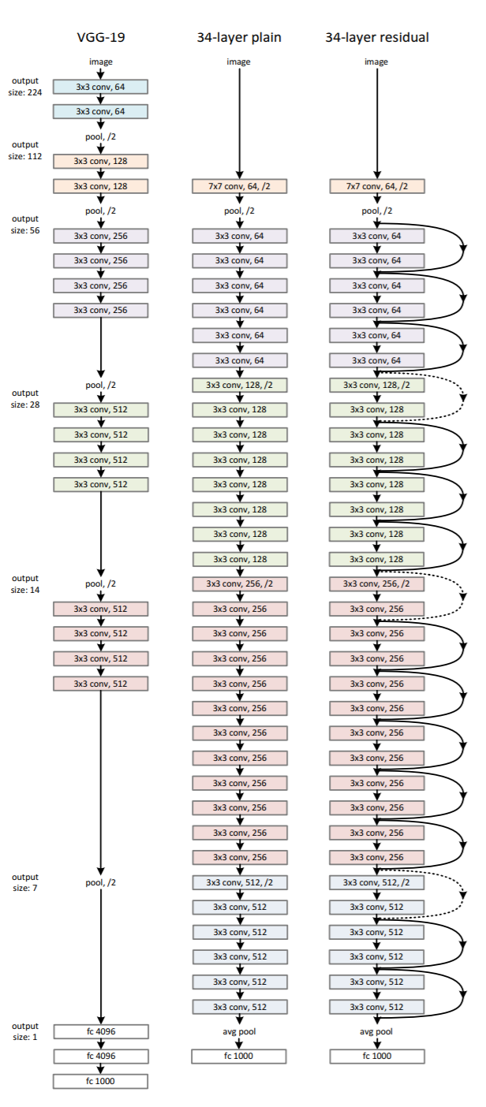
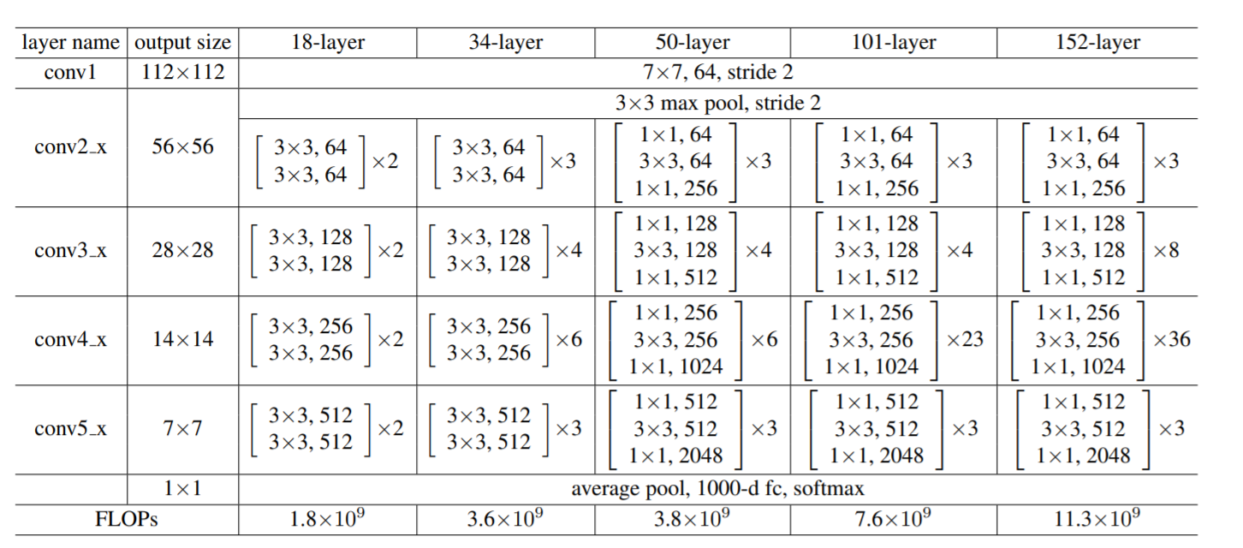
Resnet : residual connection
stride convolution
stride convolution
A lot of similarities to VGG
3x3 conv to keep image size
Use stride convolution to reduce image size
Increase number of channels while reducing image size
Much deeper – ResNet 34/50/101/152 layers
Avoid expensive FC – same as VGG
stride convolution

Slide 16
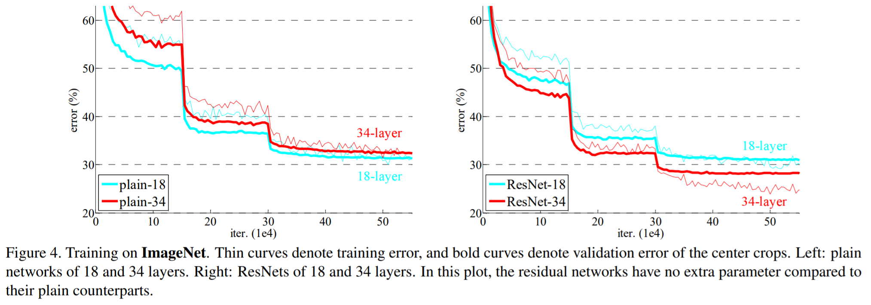
Resnet : residual connection
Top 5 accu: 6.7% → 3.6%
Better than human error (5.1%)
https://arxiv.org/abs/1409.0575
Deep Residual Learning for Image Recognition. https://arxiv.org/abs/1512.03385

Slide 17
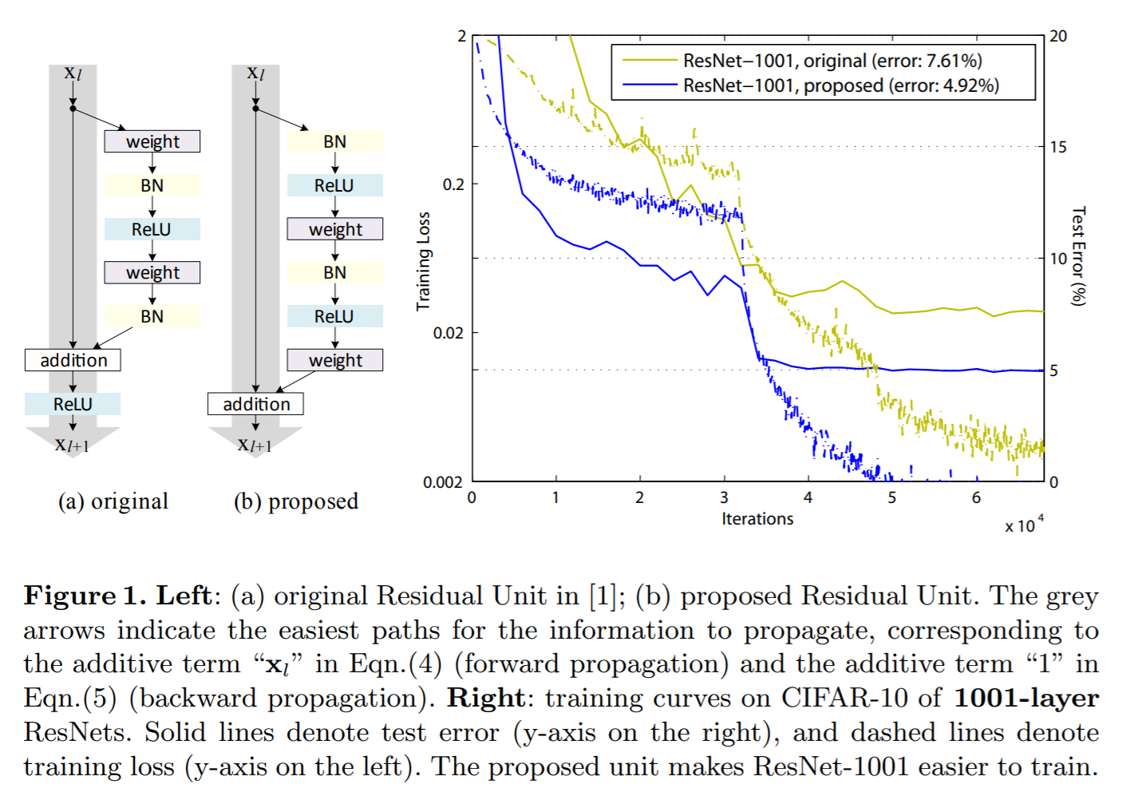
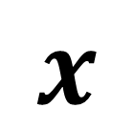
Resnet : with batch normalization
$$x$$
CONV
Use the (b) layout
Network needs input CONV layers
Identity Mappings in Deep Residual Networks. https://arxiv.org/abs/1603.05027

Slide 18
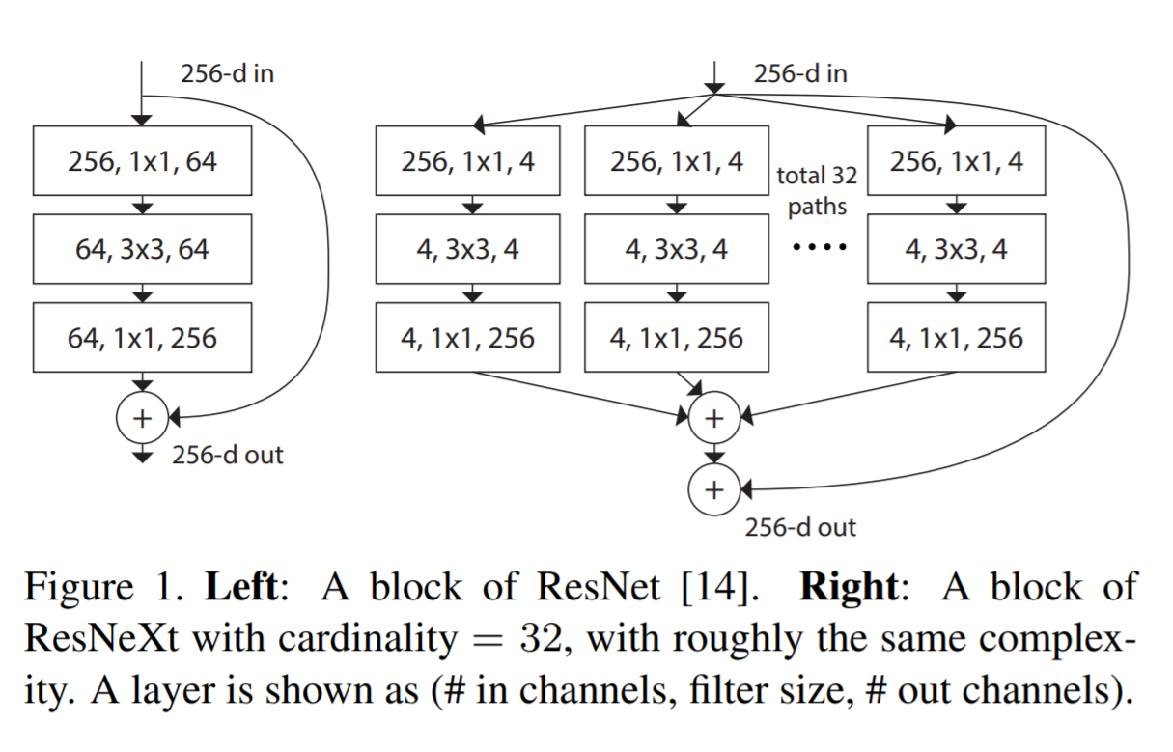
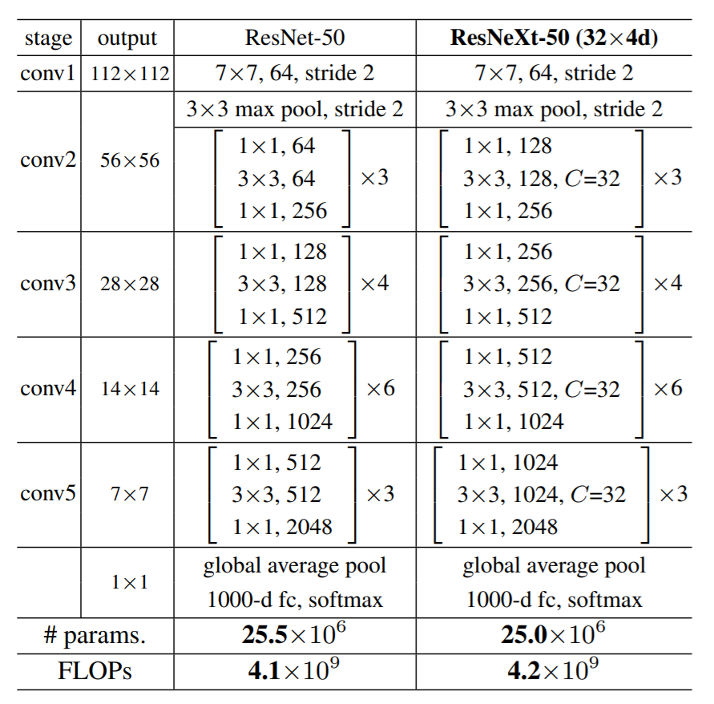
ResNeXt 2016 : wider network with skip connection
Combine the idea of inception module with residual connection
Use 1x1 conv to reduce computation
Multiple passes with homogenous architecture
Top 5 accu: 3.6% → 3.0%
Aggregated Residual Transformations for Deep Neural Networks. https://arxiv.org/abs/1611.05431

Slide 19
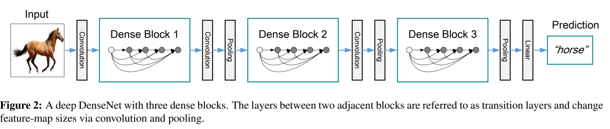
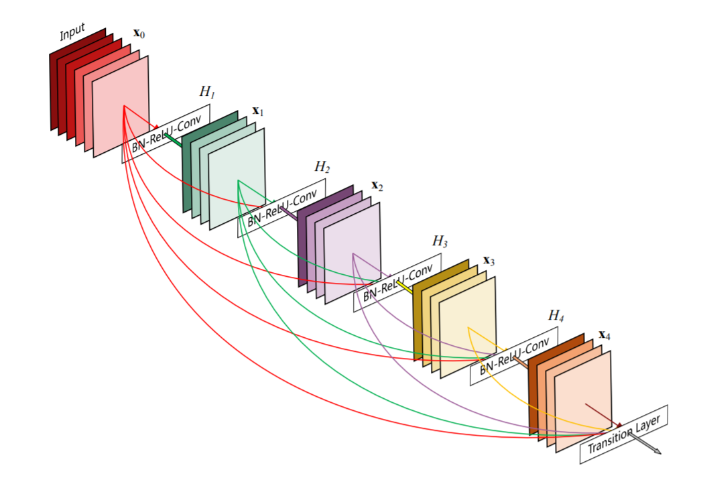
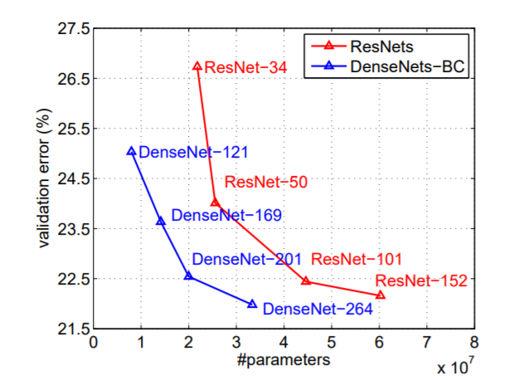
DenseNet : Densely Connected Convolutional Networks
Heavily using 3x3 and 1x1 conv
Flexible dense block design
Optionally, reduce number of feature maps by half between dense blocks (DenseNet-BC)
Densely Connected Convolutional Networks. https://arxiv.org/abs/1608.06993

Slide 20
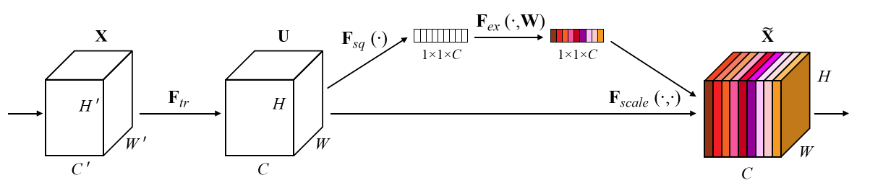
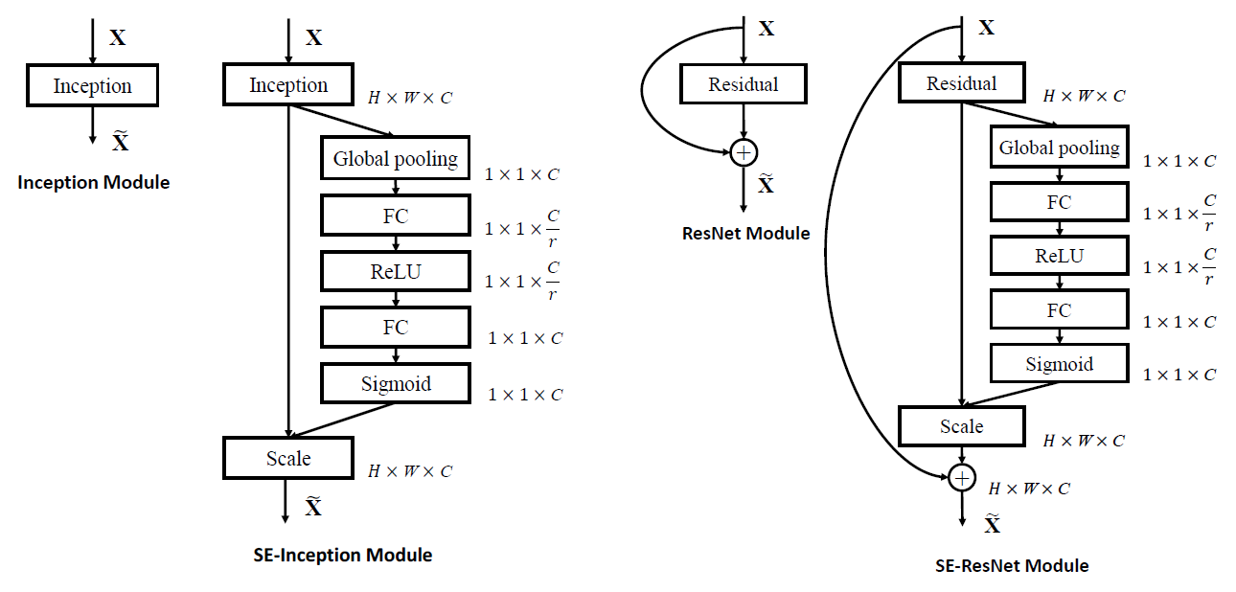
SENet 2017 : Squeeze-and-Excitation Network
A SE module to rebalance channels
First, global pooling along HxW
Then squeeze with a FC layer
Then expand it back to C channels
After sigmoid, use the C ratio to scale every channel
Relying on training to learn the best weights to rebalance channels
With SE module, every channel contributes to all other channels → similar idea is popular in attention mechanism
r can be 4, 8, 16, 32 …
Not sensitive to accuracy
Top 5 accu: 3.0% → 2.3%

Slide 21
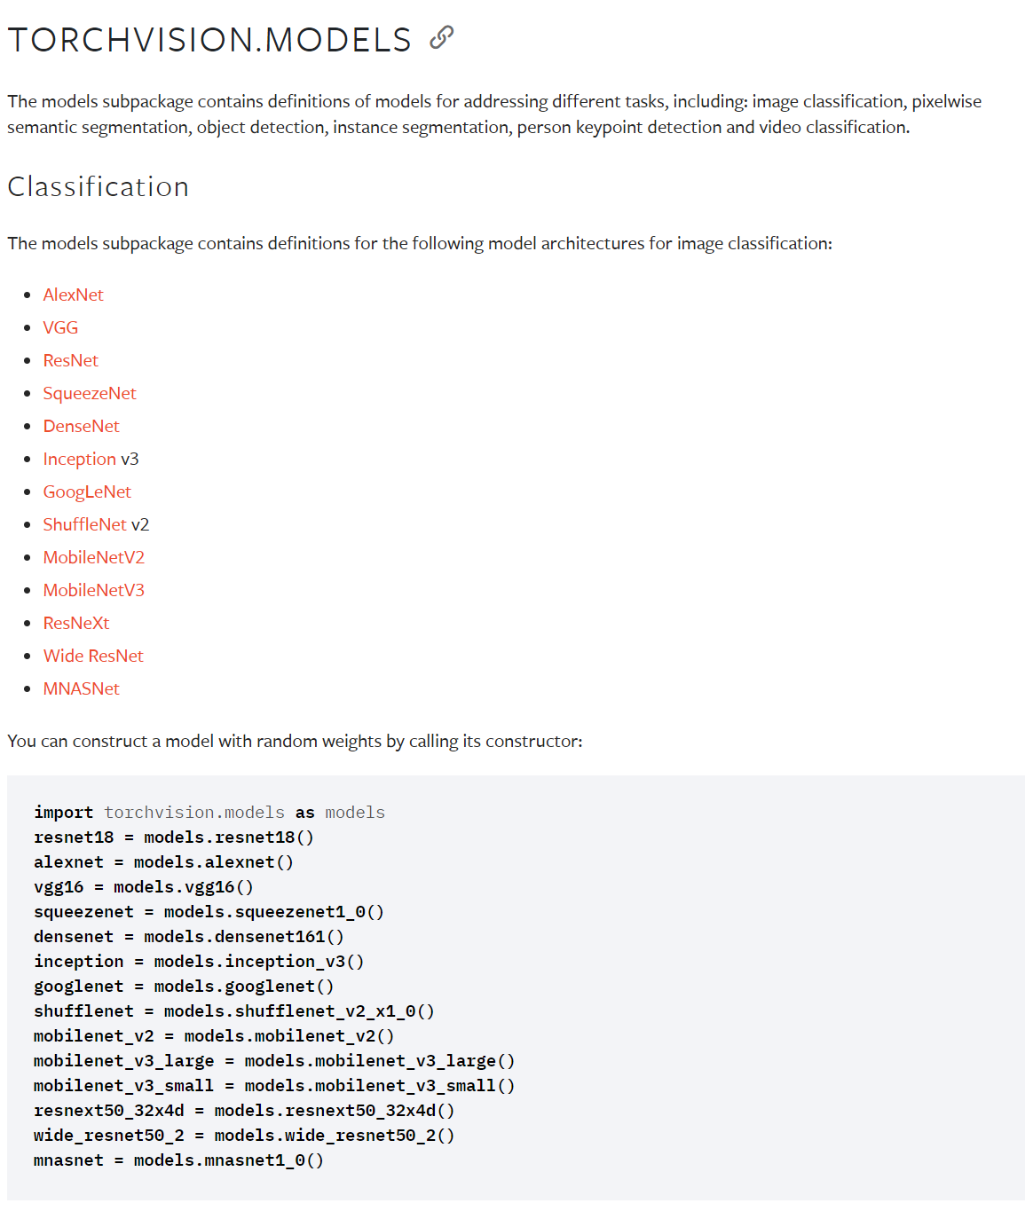
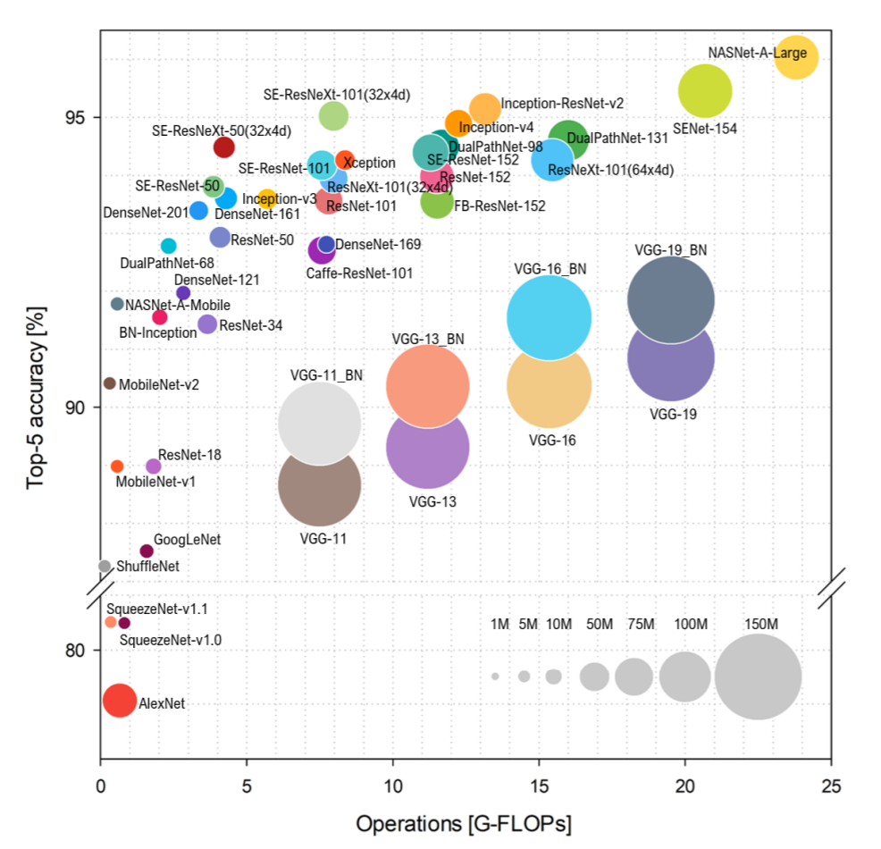
Many other models in Pytorch model zoo
Sweet spots
https://pytorch.org/vision/stable/models.html
Benchmark Analysis of Representative Deep Neural Network Architectures. https://arxiv.org/pdf/1810.00736.pdf
https://pytorch.org/serve/model_zoo.html

Slide 22
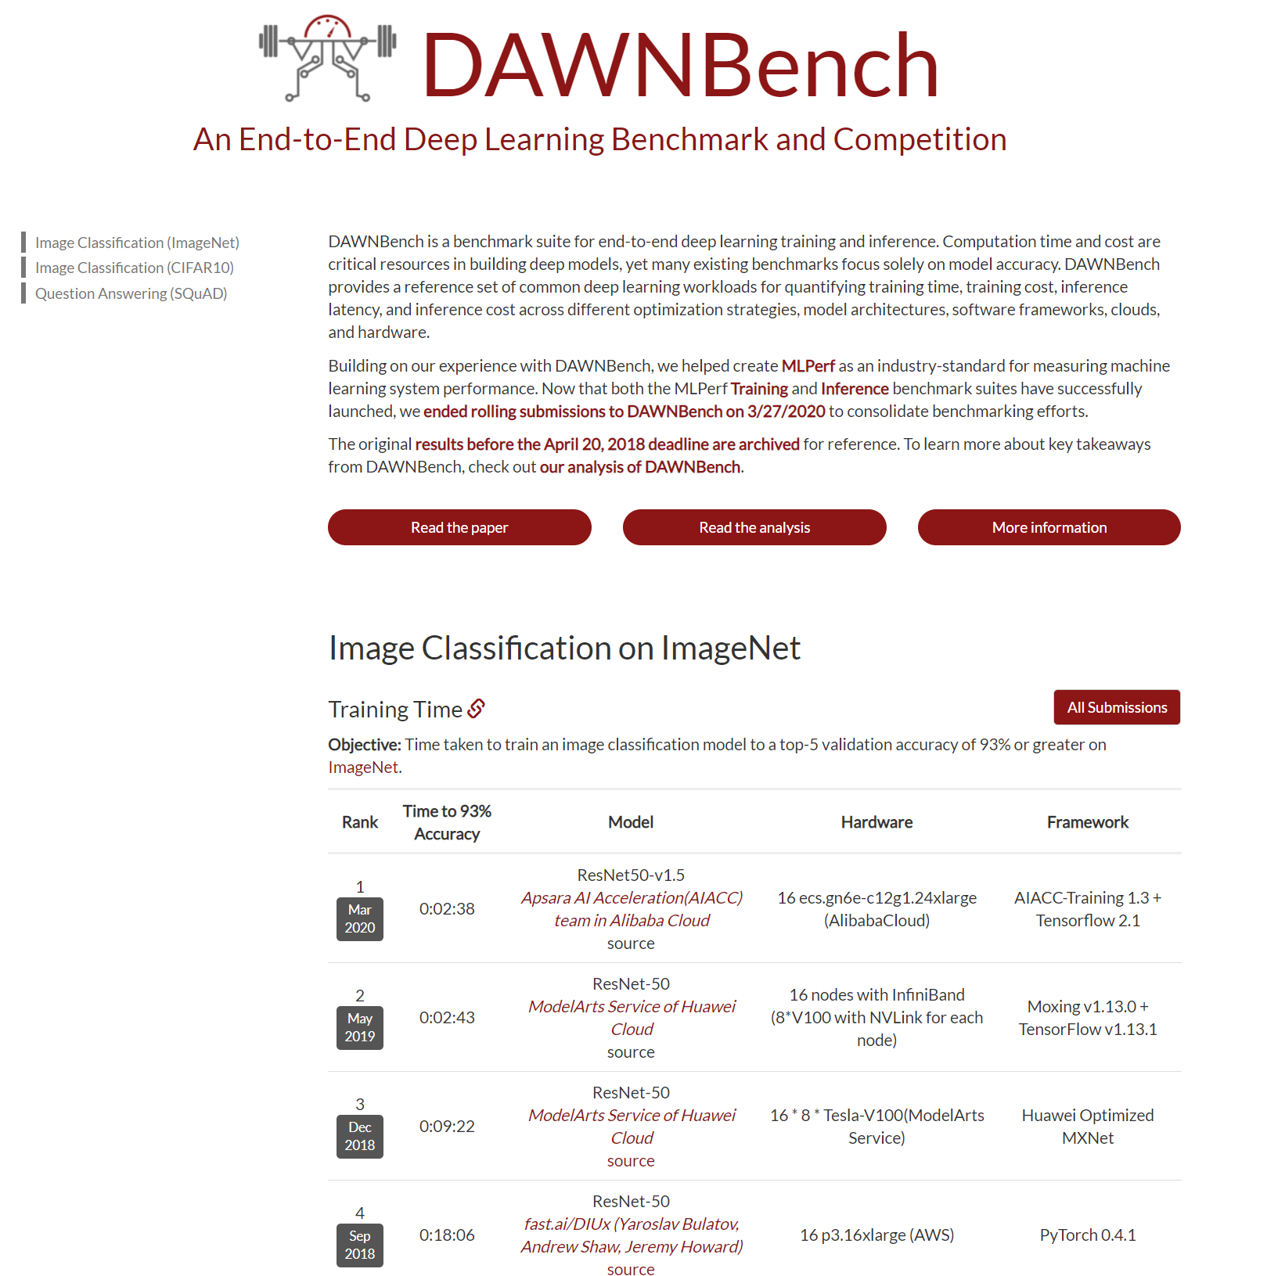
Another dimension: training speed
Sweet spots
Good balance with computation and accuracy
ResNet, ResNext, DenseNet type network with Batch normalization
Adam optimization, OneCycle scheduler
Training time
Training cost
Inference latency
Inference cost
https://dawn.cs.stanford.edu/benchmark/#imagenet-train-time

Slide 23
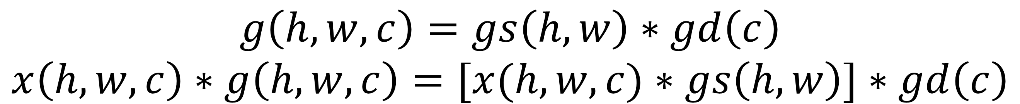
Mobile net : depth-wise separable convolution
Add the “soft constraint” to have depth separable convolution
CONV 3x3
9xKxCxHxW multiplications
CONV 3x3, depth-wise
9xCxHxW multiplications
CONV 1x1
KxCxHxW multiplications
9KC >> (9+K)C
$$g\left(h,w,c\right)=gs\left(h,w\right)∗gd\left(c\right)$$
$$x\left(h,w,c\right)∗g\left(h,w,c\right)=[x(h,w,c)∗gs\left(h,w\right)]∗gd\left(c\right)$$
CONV, 3x3
BN
ReLU
CONV, 3x3, along depth only
CONV, 1x1
BN
ReLU
BxCxHxW
BxKxHxW
BxCxHxW
BxKxHxW
3x3 conv, stride 1, padding 1, K channels
3x3 conv, stride 1, padding 1
BxCxHxW → BxCxHxW
1x1 conv, stride 1, padding 0
BxCxHxW → BxKxHxW
MobileNets: Efficient Convolutional Neural Networks for Mobile Vision Applications. https://arxiv.org/abs/1704.04861

Slide 24
Group convolution and depth-wise convolution
H’xW’, K output channels
HxW
3x3, K filters
Perform convolution for every output channel
CxHxW→ KxHxW, kenrel size k_{x}xk_{y}xCxK
… …
Normal convolution
… …
=
C
*
C
H’xW’, K output channels
HxW
3x3, K filters
Perform convolution for every group
Split along the input channel dimension
… …
Group convolution, G=2
C/2
*
… …
=
C
C/2
*
=

Slide 25
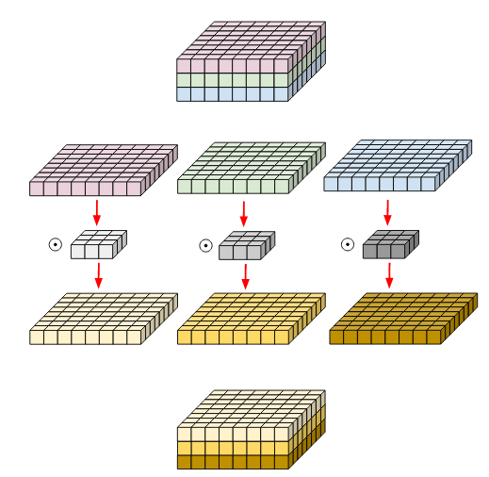
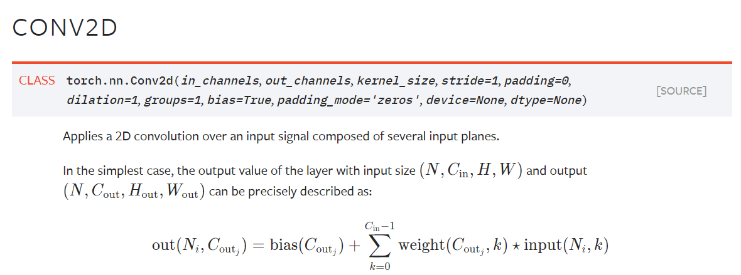
Deep-wise convolution
Depth-wise convolution is implemented with group convolution with G=C
So 2D convolution for every input channel independently
Split along input channel
convolve each channel separately
Put together along channel dimension
https://medium.com/@zurister/depth-wise-convolution-and-depth-wise-separable-convolution-37346565d4ec

Slide 26
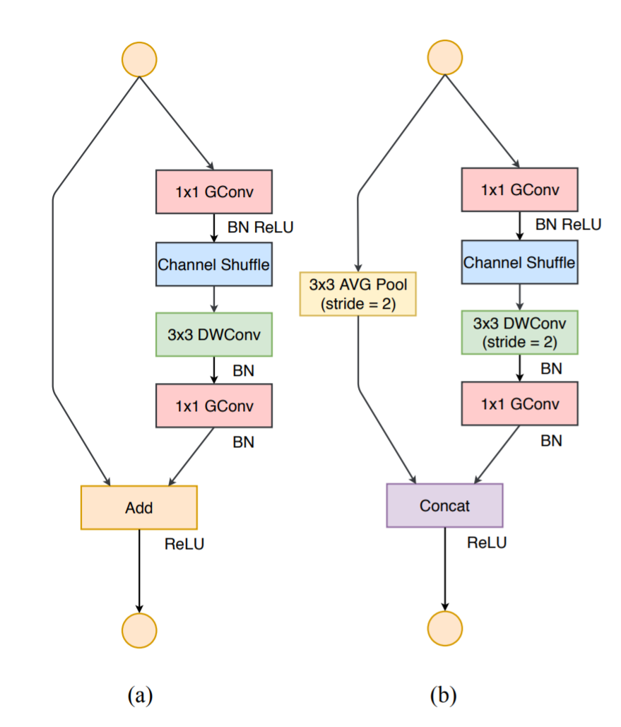
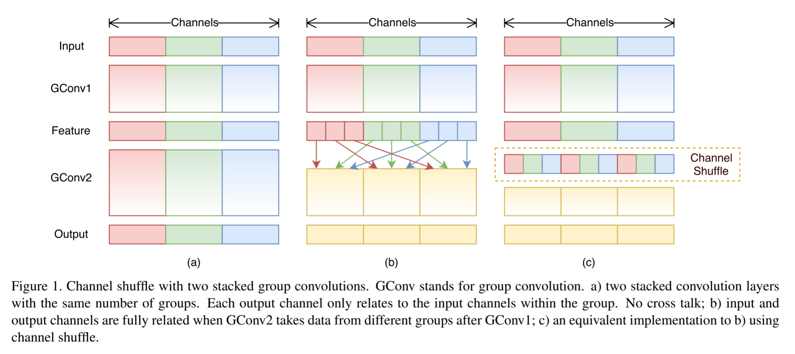
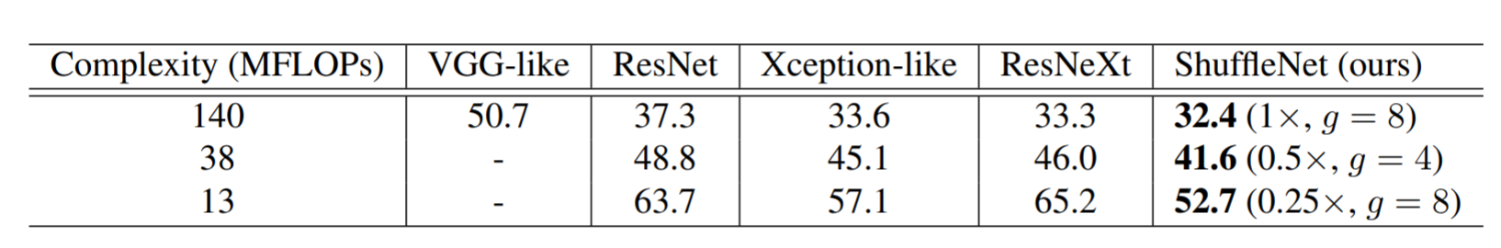
Shuffle Net : further reduce computation for 1x1 conv
1x1 CONV, CxKxHxW multiplications
1x1 group CONV, CxKxHxW /G multiplications
Since every group is processed independently, channel shuffle was added to allow intra-group interaction
Higher accuracy when model complexity is limited
Shuffle net module
ShuffleNet: An Extremely Efficient Convolutional Neural Network for Mobile Devices. https://arxiv.org/abs/1707.01083

Slide 27
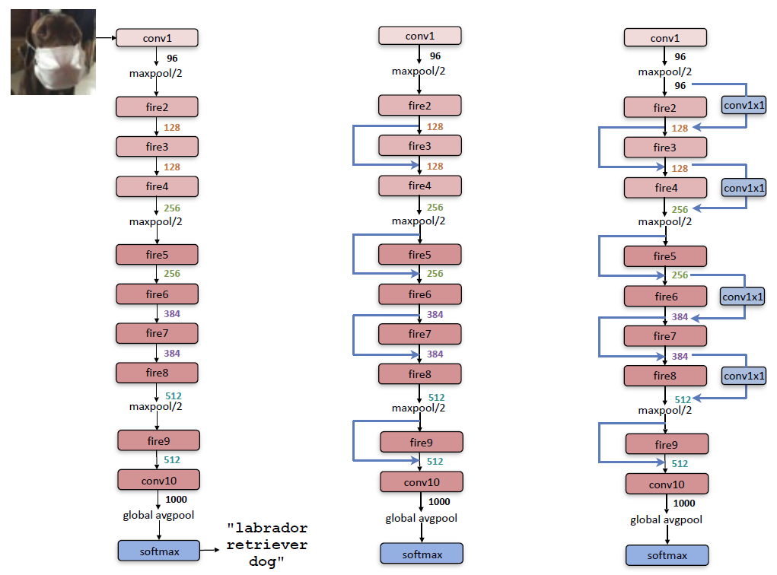
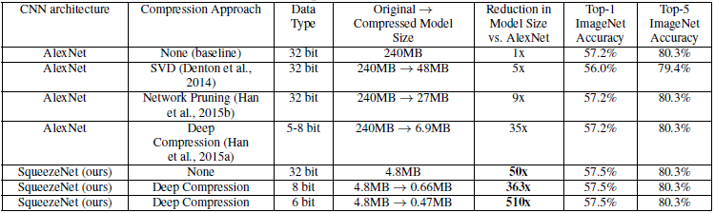
Squeeze net : AlexNet accuracy with 50x less #paras
Reduce memory size and computation while maintaining the performance
Use 1x1 conv
Introduce “fire” module
Reduce the image size at a slower pace for accuracy
CONV, 1x1, K_{1x1,e}
Fire module
Hyperparameters: number of CONV output channels
K_{1x1,s,} K_{1x1,e,} K_{3x3,s}
CONV, 1x1, K_{1x1,s}
Concatenate along channels
CONV, 3x3, K_{3x3,e}
SqueezeNet: AlexNet-level accuracy with 50x fewer parameters and <0.5MB model size. https://arxiv.org/abs/1602.07360

Slide 28
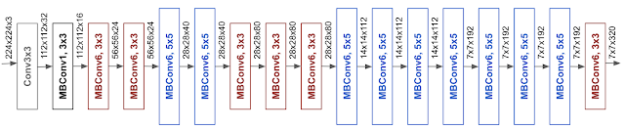
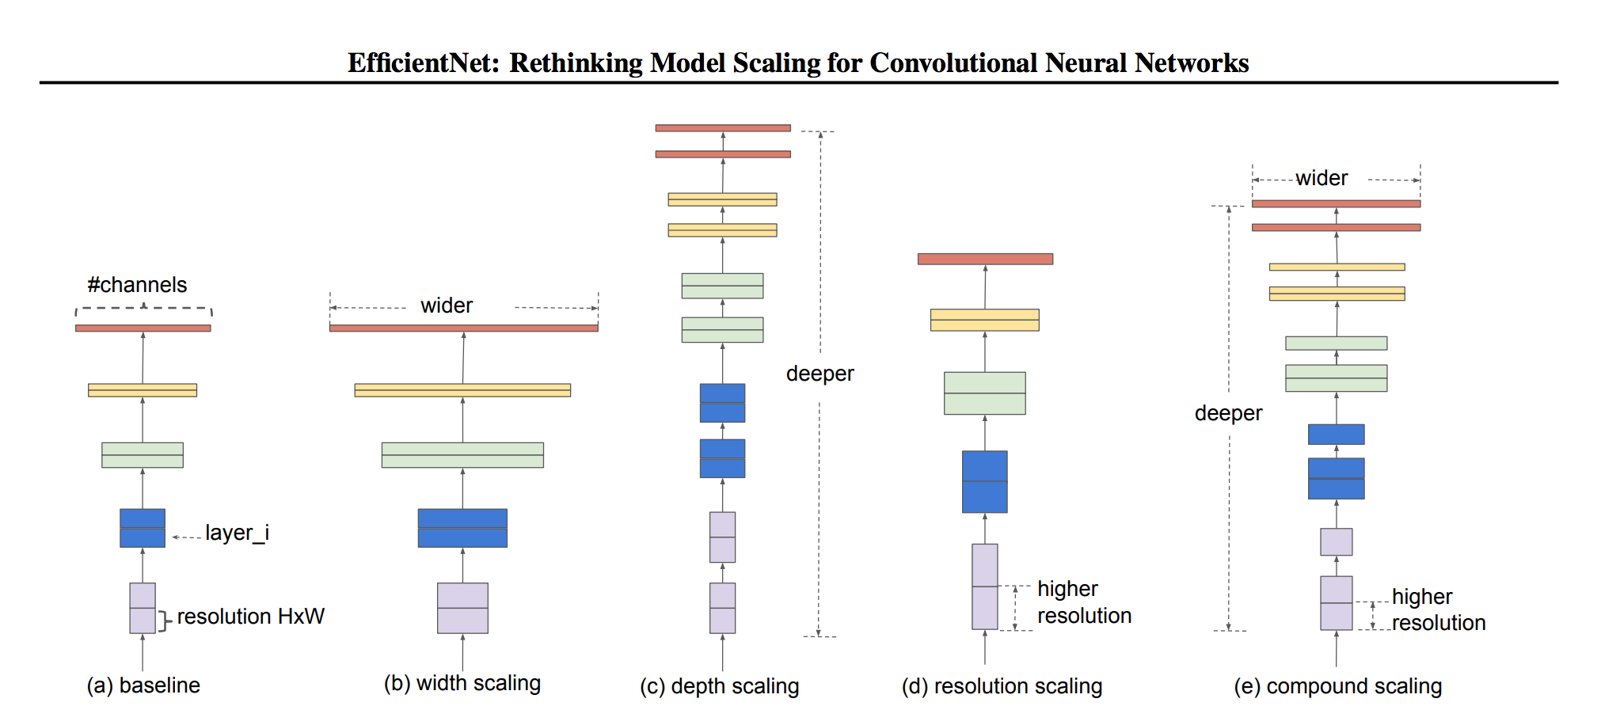
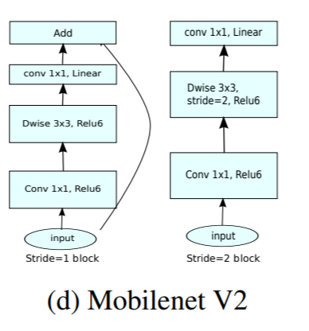
Efficient Net
Systematic way to expand network – depth, width, image resolution
Starting from a base model, search optimal expansion to grow all three aspects together
Use neural architecture search to find a good expansion
MBConv is from MobileNet V2 https://arxiv.org/pdf/1801.04381.pdf
depth :the number of layers in a network
width is the number of neurons in a layer or the number of filters in a convolutional layer
resolution is the height and width of the input tensor
EfficientNet: Rethinking Model Scaling for Convolutional Neural Networks. https://arxiv.org/abs/1905.11946

Slide 29
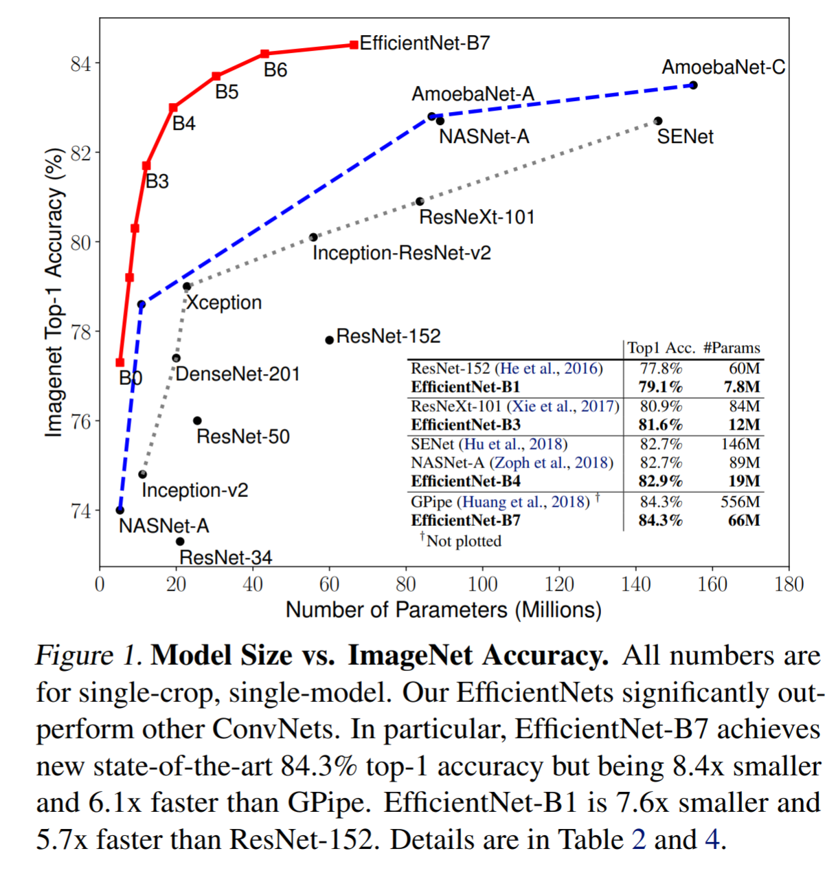
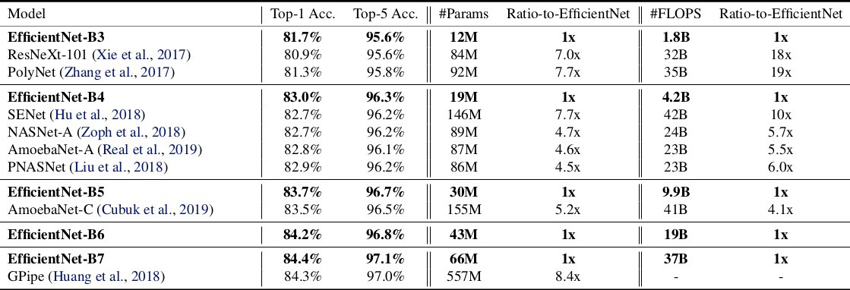
Efficient Net
Scaling up a single aspect quickly saturates the accuracy
Jointly scale up all three aspects achieved top accuracy with reduced model complexity
A systematic approach to design CNN!
EfficientNet: Rethinking Model Scaling for Convolutional Neural Networks. https://arxiv.org/abs/1905.11946

Slide 30
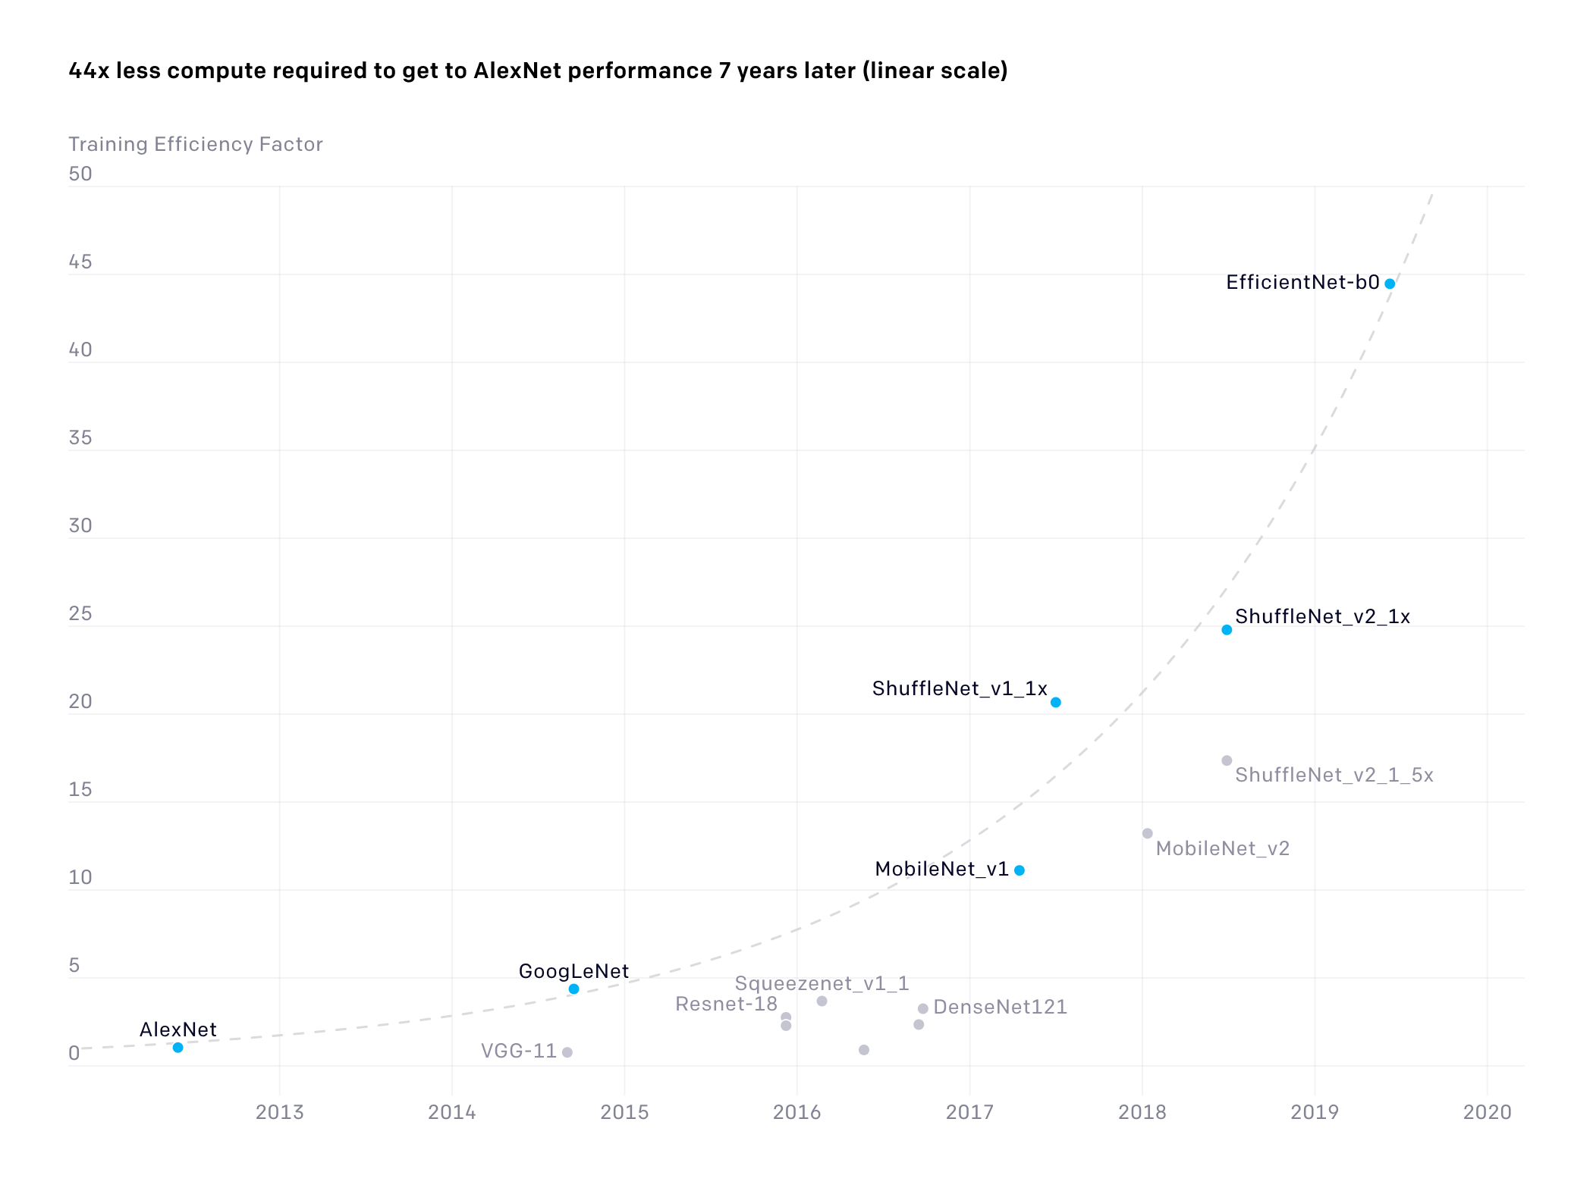
Training efficiency improves
The number of floating-point operations required to train a classifier to AlexNet-level performance on ImageNet
2x reduction every 16 months and in total of 44x reduction of computation, since 2012
Released on May, 2020
https://openai.com/blog/ai-and-efficiency/
Measuring the Algorithmic Efficiency of Neural Networks. https://arxiv.org/abs/2005.04305

Slide 31
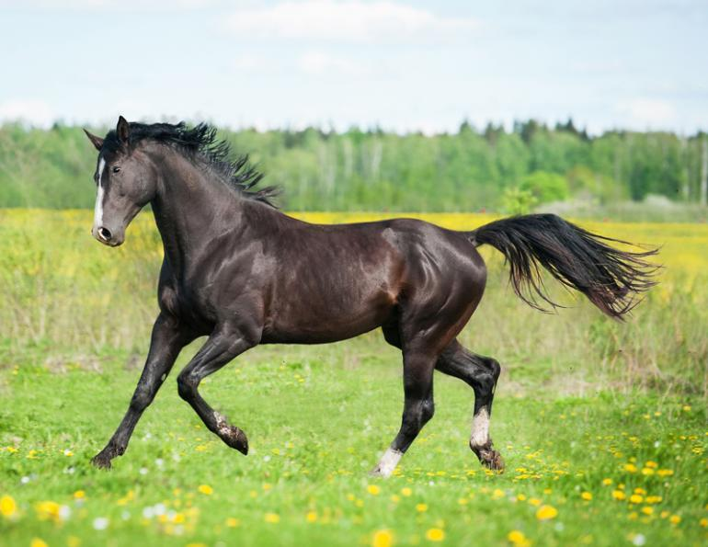
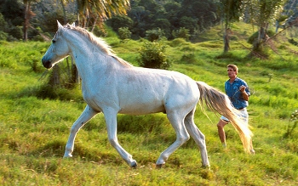
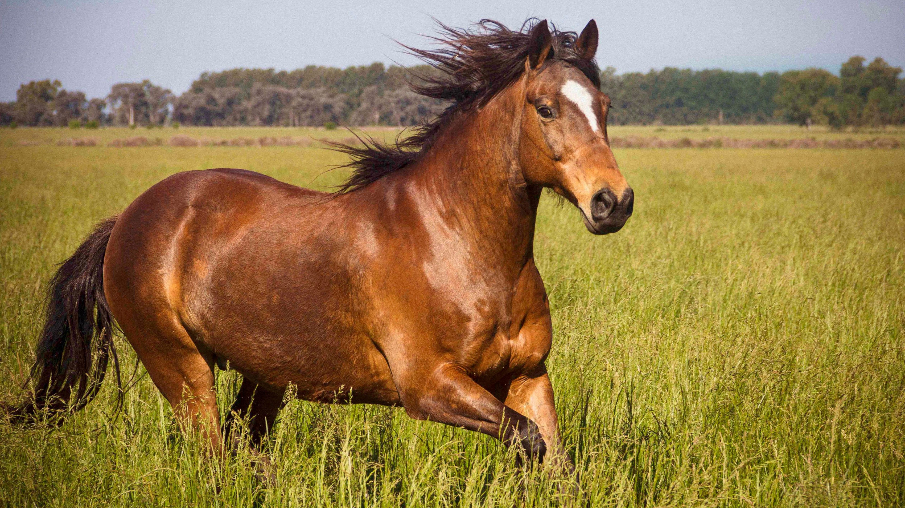
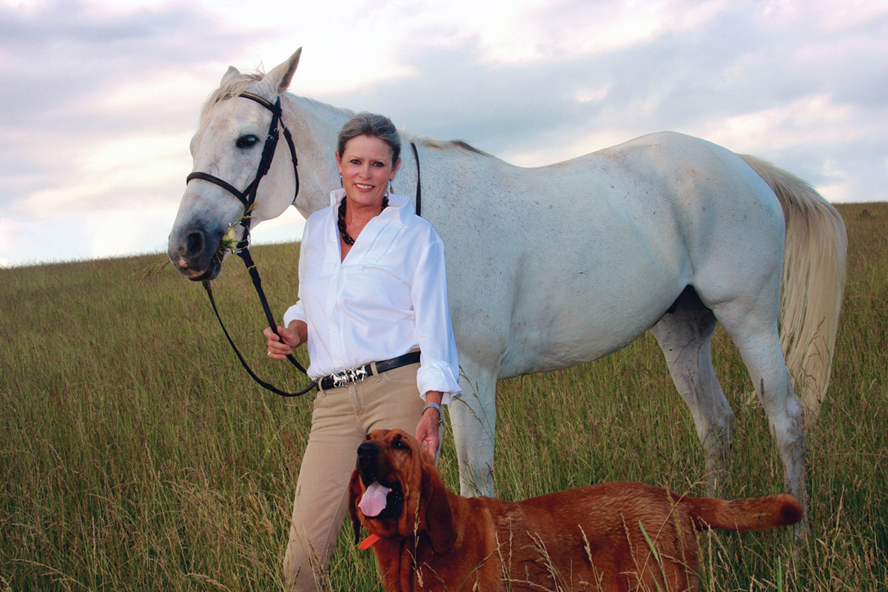
Task definition
horse + its BB
horse + its mask
horse
horse + bounding box (x, y, H, W)
human + his BB
human + his mask
… …
dog + its mask
Classification: given an image, output the object class
Localization: given an image, output the object class and its bounding box
Detection: given an image, detect all objects. For each object, output its class and bounding box
Instance segmentation: given an image, detect all objects. For each object, output its class and bounding box
One object
multiple objects

Slide 32
Object detection
Detect multiple objects
Need to be fast and accurate
Foundation of many consumer products
Two-stage object detector
Region proposal
Single-stage object detector
Final BB and classes

Slide 33
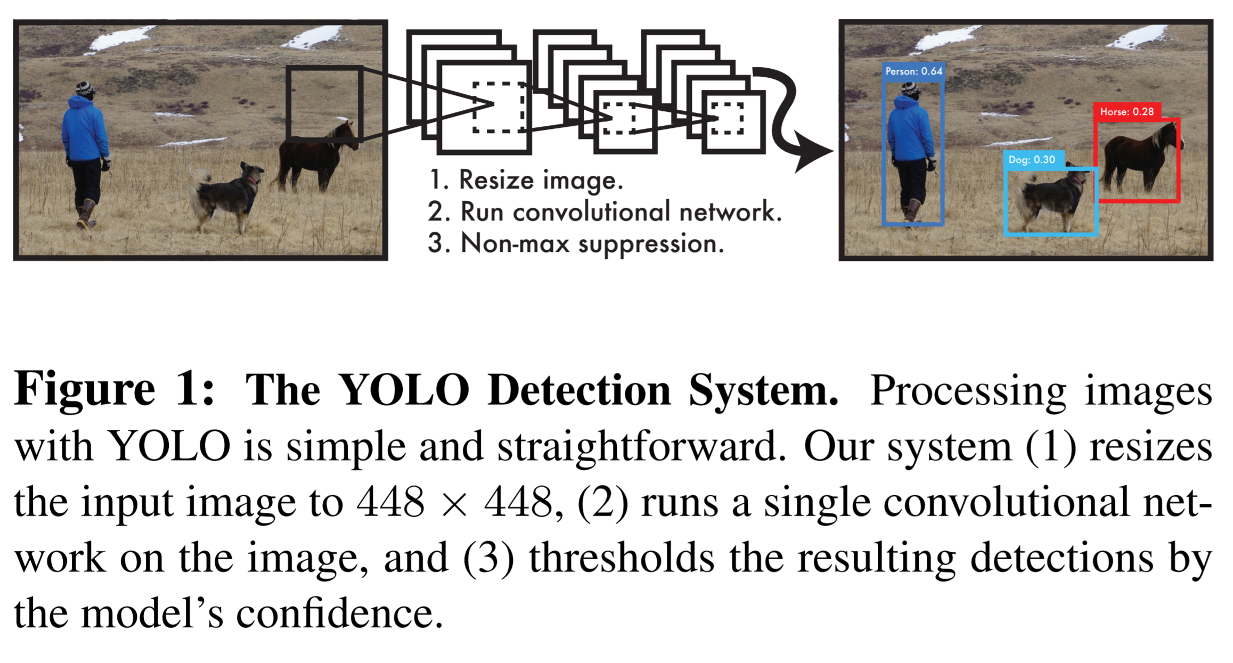

YOLO: You Only Look Once
Single stage detector
Very fast and accurate, enable real-time detection
Envolve from v1 to v5
https://pjreddie.com/publications/
https://youtu.be/MPU2HistivI?t=27

Slide 34
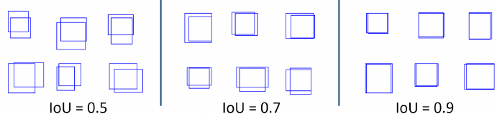
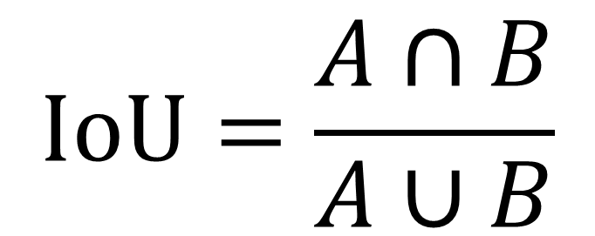
IoU: Intersection over union
$$IoU=\frac{A∩B}{A∪B}$$

Slide 35
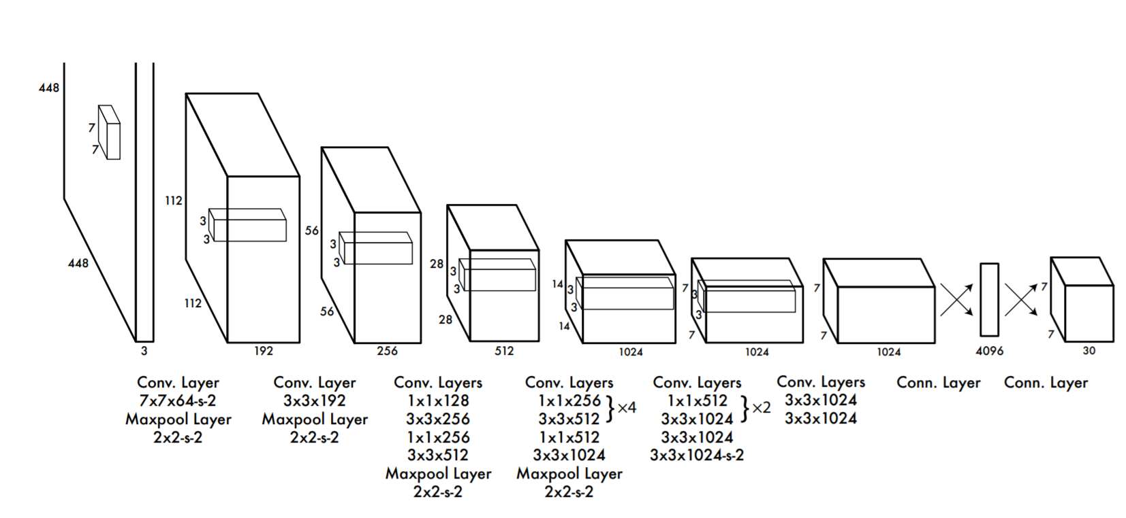

How the YOLO works
Pick a CNN backbone network
On the final conv layer, image is downsampled to a 7x7 feature maps
Every feature has a large receptive field in the origin image
You Only Look Once: Unified, Real-Time Object Detection. https://arxiv.org/abs/1506.02640

Slide 36

How the YOLO works
Key idea: every cell predicts B bounding boxes with object classes
Every cell predicts :
$p_{object}$, $b_{x}$, $b_{y}$, $b_{w}$, $b_{h}$, $[p_{1},$ $p_{2}, …,p_{C}]$
Whether this cell has an object
Bounding box center, width and height
class scores for all classes
You Only Look Once: Unified, Real-Time Object Detection. https://arxiv.org/abs/1506.02640

Slide 37

How the YOLO works
YOLO v1 paper said to output $[p_{1},$ $p_{2}, …,p_{C}]$ for every cell
Since YOLO v2, model outputs class probabilities for every bounding box
For 7x7 cell, B=2, C=20,
YOLO outputs a tensor 7x7x(2x(5+20))=7x7x50
You Only Look Once: Unified, Real-Time Object Detection. https://arxiv.org/abs/1506.02640

Slide 38


How the YOLO works
C is the confidence, computed with IoU
At training time, among the B bounding boxes for a cell, one with highest IoU with ground-truth is made “responsible”
You Only Look Once: Unified, Real-Time Object Detection. https://arxiv.org/abs/1506.02640

Slide 39



How the YOLO works
With one forward pass, a lot of bounding boxes are estimated, together with $p_{object}$ and class probability
Compute confidence as $p_{object}×IoU\left({BB}_{pred, }{BB}_{truth }\right)$
Threshold with confidence >0.3 and NMS
non-max suppression
Step 1: Select the box with highest objectiveness score
Step 2: Then, compare the overlap (intersection over union) of this box with other boxes
Step 3: Remove the bounding boxes with overlap (intersection over union) >50%
Step 4: Then, move to the next highest objectiveness score
Step 5: Finally, repeat steps 2-4
https://www.analyticsvidhya.com/blog/2020/08/selecting-the-right-bounding-box-using-non-max-suppression-with-implementation/
You Only Look Once: Unified, Real-Time Object Detection. https://arxiv.org/abs/1506.02640

Slide 40


YOLO v1 to v5
YOLO v1 : You Only Look Once: Unified, Real-Time Object Detection. https://arxiv.org/abs/1506.02640
YOLO v2 : YOLO9000: Better, Faster, Stronger. https://arxiv.org/abs/1612.08242
YOLO v3: YOLOv3: An Incremental Improvement. https://arxiv.org/abs/1804.02767
YOLO v4: Optimal Speed and Accuracy of Object Detection. https://arxiv.org/abs/2004.10934v1
YOLO v5: https://github.com/ultralytics/yolov5

Slide 41

SSD: single shot detector
Another one-stage detector
Use multiple conv feature maps
SSD: Single Shot MultiBox Detector. https://arxiv.org/abs/1512.02325

Slide 42

R-CNN : two stage detector
Find regions which may contain objects → region proposal
For every candidate region, run a CNN to predict object class and correction for the bounding box
4096D feature vector
Very slow detection - ~50s per image
First time show the detection can be done for ~1000 classes of objects
Pre-trained AlexNet
~2000 candidate regions
CONV1
ReLU
Max Pool
CONV2
ReLU
Max Pool
CONV3
ReLU
CONV4
ReLU
CONV5
ReLU
Max Pool
Flatten
FC1
ReLU
FC2
Bounding-box regressor for adjustment on [dBx, dBy, dBh, dBw]
Warped to 3x227x227
SVM classifier for object class
Warped to 3x227x227
CONV1
ReLU
Max Pool
CONV2
ReLU
Max Pool
CONV3
ReLU
CONV4
ReLU
CONV5
ReLU
Max Pool
Flatten
FC1
ReLU
FC2
BB regressor
SVM
Region proposal algorithm
Warped to 3x227x227
CONV1
ReLU
Max Pool
CONV2
ReLU
Max Pool
CONV3
ReLU
CONV4
ReLU
CONV5
ReLU
Max Pool
Flatten
FC1
ReLU
FC2
BB regressor
SVM
http://vision.stanford.edu/teaching/cs231b_spring1415/slides/ssearch_schuyler.pdf
Rich feature hierarchies for accurate object detection and semantic segmentation. https://arxiv.org/abs/1311.2524

Slide 43
Fast R-CNN : region proposal on feature maps
Work on the CNN feature maps
Only need one pass for backbone network
Much faster than R-CNN
FC
FC
FC
softmax
Object class
Resize feature regions (ROI pooling)
FC
BB adjustments
FC
FC
FC
softmax
Object class
CONV1
ReLU
Max Pool
CONV2
ReLU
Max Pool
CONV3
ReLU
CONV4
ReLU
CONV5
FC
BB adjustments
FC
FC
FC
softmax
Object class
Feature maps
FC
BB adjustments
Fast R-CNN. https://arxiv.org/abs/1504.08083

Slide 44



Faster R-CNN : add region proposal network
Add region proposal network
End-to-end training
Classification loss
BB adjustment loss
For every location in feature maps
Consider k anchor boxes at each location
For every anchor box, predict $p_{object}$, ${db}_{x}$, ${db}_{y}$, $db_{w}$, ${db}_{h}$ → similar to YOLO, but for region proposal
Jointly optimize four losses
BB adjustment loss
RPN: region proposal network
Classification loss
Faster R-CNN: Towards Real-Time Object Detection with Region Proposal Networks. https://arxiv.org/abs/1506.01497

Slide 45


Mask R-CNN : add segmentation layer
For every bounding box, segment the object
One object per bounding box
Instance segmentation
Classification loss
BB adjustment loss
BB adjustment loss
Classification loss
Mask R-CNN. https://arxiv.org/abs/1703.06870
https://github.com/matterport/Mask_RCNN

Slide 46


Put them together
YOLO v5
YOLO v2
https://github.com/facebookresearch/detectron2
Speed/accuracy trade-offs for modern convolutional object detectors. https://arxiv.org/abs/1611.10012
Object Detection in 20 Years: A Survey. https://arxiv.org/abs/1905.05055

Slide 47

Usecase discrepancy: Object detection vs. Imaging
Don’t know what is in the image
Large number of object classes
Less accurate segmentation is ok
Require real-time processing
Segmentation is limited by the low resolution of conv feature maps
Know what is imaged, from protocols
Small number of object classes
Very accurate segmentation is needed
Often do not require real-time processing, e.g. <500ms for a model call is ok in most cases

Slide 48

Segmentation : output the full resolution
Encoder-decoder architecture
Gradually reduce image size, increase number of filters
Bottle-neck at the very low-resolution layers
Learning Deconvolution Network for Semantic Segmentation. https://arxiv.org/abs/1505.04366
Fully Convolutional Networks for Semantic Segmentation. https://arxiv.org/abs/1411.4038

Slide 49

Segmentation : U-net
Encoder-decoder architecture
Gradually reduce image size, increase number of filters
Remove the bottle-neck at the very low-resolution layers by adding the long-range skip-connections
Downsample/upsample layers
Concatenate the filters, not add → compare to the residual connection
Allow network to use information from different resolution levels
skip-connection
transpose conv, half the channels
Concatenate to have 1024 channels
U-Net: Convolutional Networks for Biomedical Image Segmentation. https://arxiv.org/abs/1505.04597

Slide 50
Segmentation : ResU-net
Add short-range residual connections in each block
Use interpolation for down/upsample
Add batch normalization
Downsample branch increases number of channels
Upsample branch decreases number of channels
Road Extraction by Deep Residual U-Net. https://arxiv.org/abs/1711.10684
Landmark detection in Cardiac Magnetic Resonance Imaging Using A Convolutional Neural Network. https://arxiv.org/abs/2008.06142

Slide 51





Segmentation : Output layer and loss
Single-class segmentation
One target object in the label
B, C, H, W
B, K, H, W
C=1
No need to count background
… …
… …
… …
Multi-class segmentation
More than one target objects in the label
$$ℓ=\frac{1}{HW}\sum_{i=0}^{HW−1}{BCE_loss(i)}$$
C=1
$$ℓ=\frac{1}{HW}\sum_{i=0}^{HW−1}{CE_loss(i)}$$
C=7+1
Need to count background
C>1

Slide 52






Segmentation : applied to landmark detection
More robust than L2 regression
Consider surrounding context to detect landmarks
Handle the occlusion nicely
Robust Facial Landmark Detection via a Fully-Convolutional Local-Global Context Network.CVPR 2018.
Landmark detection in Cardiac Magnetic Resonance Imaging Using A Convolutional Neural Network. https://arxiv.org/abs/2008.06142

Slide 53



Denoising CNN: DnCNN
Image + white noise as input
Noise as output → residual learning (BL)
Image is cropped to random patches and these patches are used for training → patch training
Many further development on top of this work
Beyond a Gaussian Denoiser: Residual Learning of Deep CNN for Image Denoising. https://arxiv.org/abs/1608.03981

Slide 54





Denoising with imaging physics
Develop for consumer electronics
Not optimal for medical imaging
Model
Loss
function
White
noise
Adjust model parameters
G-factor map, from imaging physics, to show the noise distribution
Model
Loss
function
Clean images
Images with real noise
Integrate imaging physics knowledge
General-purpose Deep Learning Image Denoising based on Magnetic Resonance Imaging Physics. US Patent application.

Slide 55



Single-image super-resolution CNN
the low-resolution input is first upscale to the desired size using bicubic interpolation
The 1st CONV extracted patches from low-res image and convert them to low-res feature map
The 2nd CONV converts low-res feature map to high-res feature map
The last CONV locally combined high-res feature maps to get the high-res image
L2 norm as the loss
Inspire tons of following work …
Image Super-Resolution Using Deep Convolutional Networks. TPAMI 2016.

Slide 56


A lot more is out there …
https://github.com/aiff22/PyNET
https://arxiv.org/pdf/2002.05509.pdf
https://www.paperswithcode.com/area/computer-vision

